Slide 1


Small particle flow cytometry using 3 light scatter detectors enhances EV analysis Presentation and Supplementary Data for CYTO2022
June , 2022
Desmond Pink ^{1,2} , Arghya Basu^{1,2}, Juliana Valencia, ^{1,2}, Diana Pham ^{1,2}, John D. Lewis^{1,2}
¹ Department of Experimental Oncology, Faculty of Medicine and Dentistry, University of Alberta, Edmonton, Canada
² Nanostics Precision Health, Edmonton, Alberta, Canada

Slide 2
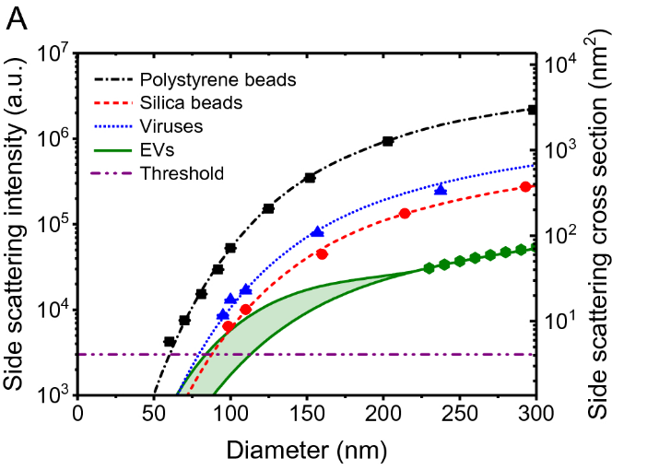
1. Introduction
Extracellular vesicle analysis using “small particle” flow cytometry would be greatly enhanced if data from materials of different refractive index (RI) could be segregated. Likewise, relative sizing of EVs using small particle flow cytometry is confounded by the influence of RI on light scatter. Beads of different composition and refractive index scatter light differently, so that small beads of high RI and large beads of lower RI can have overlapping signals on a two-dimension light scatter plot.
As particle size decreases, light scatter intensity profiles eventually merge regardless of refractive index.
In this project, we aimed to demonstrate graphically,
the enhancement of EV flow analysis when using an additional angle of light scatter collection (medium angle of light scatter, MALS) to identify different sample components (e.g. lipids, protein, extracellular vesicles) and
the practical reality of sample component overlap at different particle sizes.
Pol et al. Scientific Reports volume 11, Article number: 24151 (2021)

Slide 3
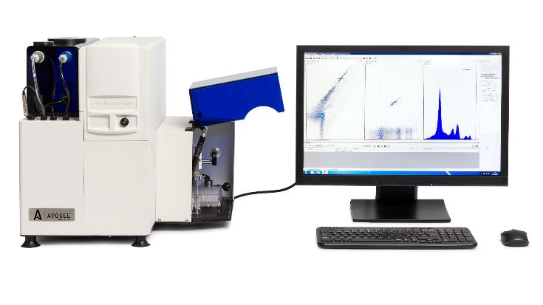

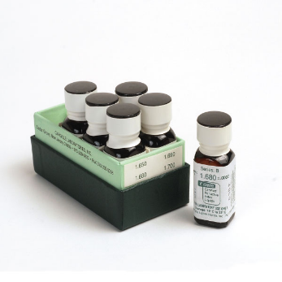
2. Methods
An Apogee A60 Micro-Plus outfitted with a third (medium) angle of light scatter (MALS) collection was used to analyze samples typical of EV analysis.
Events were triggered solely by MALS excited from a 405nm laser.
NIST bead (70-400nm) and silica bead standard mixtures (100-400nm) were analyzed first to define cytometer settings.
Refractive index oil emulsion standards (RI 1.38, 1.42, 1.59, Cargille) were prepared to generate a continuum of particle sizes; each emulsion was analyzed separately.
The multi-angle light scatter data from each RI standard was plotted to yield the distinct pattern of particle size (light scatter intensity) influenced by refractive index.
Refractive index oil standards were analyzed under standard analysis conditions.
Analysis of oil standards is time consuming and potentially leaves the platform extremely “dirty”.
These types of standards are not suitable for daily analyses and should only be used by operators with significant technical expertise.

Slide 4
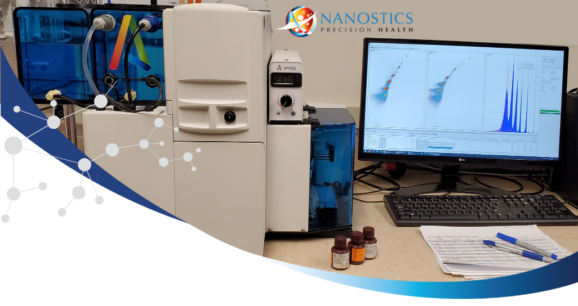

2. Methods: Instrument Set Up
Cytometer Settings
Platform | Apogee A60 MP | S/N 0130
Parameter | Setting |  | Parameter | Setting
Flow Rate | 0.75 -3.01 µL/min |  | Trigger | MALS
Pressure | 150 units |  | Sample volume | 10 µL
Acquisition time | 60 - 120 sec |  | Diluent | PBS
Sample Dilution | 50-10⁶PBS |  | Diluent | PBS
Channel | Laser Power (mW) | PMT (v) | Gain | Threshold
405nm | 85 | --- | --- | ---
488nm | 70 | --- | --- | ---
561nm | 70 | --- | --- | ---
638nm | 70 | --- | --- | ---
405-SALS | --- | 370 | 1.0 | ---
405-LALS | --- | 385 | 1.0 | ---
405-MALS | --- | 380 | 1.0 | 27
405-Blue | --- | 505 | 1.0 | ---
405-Green | --- | 575 | 1.0 | ---
488-Green | --- | 480 | 1.0 | ---
488-Orange | --- | 300 | 1.0 | ---
488-Red | --- | 310 | 1.0 | ---
561-Orange | --- | 510 | 1.0 | ---
561-Red | --- | 770 | 1.0 | ---
638-Red | --- | 500 | 1.0 | ---
638-Far Red | --- | 300 | 1.0 | ---

Slide 5
2. Materials
Product | Product # | Attribute | Lot # | Company
Calibration Mix | 1524 | Mixture Si/PS | CAL0143 | ApogeeFlow Systems
Monitoring Mix | 1527 | Mixture Si/PS | CAL0145 | ApogeeFlow Systems
NIST 70nm PS | 3070A | 70nm±3nm | Lot#: 230764 | ThermoScientific
NIST 80nm PS | 3080A | 81nm±3nm | Lot#: 229986 | ThermoScientific
NIST 90nm PS | 3090A | 92nm±3nm | Lot#: 231451 | ThermoScientific
NIST 100nm PS | 3100A | 100nm±4nm | Lot#: 231703 | ThermoScientific
NIST 125nm PS | 3125A | 122nm±3nm | Lot#: 230329 | ThermoScientific
NIST 150nm PS | 3K-150 | 152nm±5nm | Lot#: 232375 | ThermoScientific
NIST 200nm PS | 3200A | 203nm±4nm | Lot#: 232366 | ThermoScientific
100nm Silica | SISN100 | 104nm±9nm | Lot# JEA0234 | NanoComposix
120nm Silica | SISN120 | 119nm±6nm | Lot# JRC0354 | NanoComposix
200nm Silica | SISN200 | 194nm±16nm | Lot# JEA0232 | NanoComposix
300nm Silica | SISN300 | 300nm±12nm | Lot# SCM0179 | NanoComposix
400nm Silica | SISN400 | 389nm±4nm | Lot# JRC0354 | NanoComposix
Verity Small | vero1A | 189nm±2nm | NA | Exometry
Verity Large | vero1B | 374nm±10nm | NA | Exometry
Biologicals | Product # | Attribute | Lot # | Company
IntraLipid (20%) | I141 | 20% emulsion | MKCG7221 | Sigma Aldrich
Abnormal Lipids | LRC 03 | Xs Chol, TGs, Lps | 3527 | SolomonPark
Excess protein | INT-01P | Albumins, γ-globulins | 0314721 | Sun Diagnostics
Anti-CD41-SB436 | 62-0419-41 | Primary Ab | 2056117 | ThermoScientific
Anti-CD63-APC | 130-111-020 | Primary Ab | 52103004403 | Miltenyi Biotec
GoatantiMs-AF488 | A31620A | Secondary Ab | 2342829 | Invitrogen
Plasma | APCaRI | EDTA plasma |  | Nanostics
Serum | APCaRI | SST serum |  | Nanostics
Urine | APCaRI | First catch |  | Nanostics
Semen | APCaRI | Standard sample |  | Nanostics
Oil Emulsions | Product # | Attribute | Lot # | Company
Refractive Index Oil | 1803 | Series AAA 1.38000 | 0521 | Cargille
Refractive Index Oil | 1806 | Series AAA 1.42000 | 0321 | Cargille
Refractive Index Oil | 1809 | Series AAA 1.59000 | 0920 | Cargille
Analysis Software | Attribute | Version |  | Company
FCS Express 7 | Flow RUO | 7.10.0007 |  | DeNovo Software
Origin Pro 2022 | (64-bit) SR1 | 9.9.0.225 |  | OriginLab Corporation
GraphPad Prism | Prism 9 64bit | 9.3.1.471 |  | Dotmatics

Slide 6
Section 3.
How well do common bead standards match with refractive index oil emulsions?
NIST bead (70 -200nm) and silica bead standard mixtures (100-400nm) were analyzed first to define cytometer settings.
Refractive index (Cargille) oil emulsion standards (RI 1.38, 1.42, 1.59) were prepared to generate a continuum of particle sizes; each emulsion was analyzed separately.
The multi-angle light scatter data from each RI standard was plotted to yield the distinct pattern of particle size influenced by refractive index.
Data was abbreviated for some samples to show only ~10,000 events simply for clarity.

Slide 7
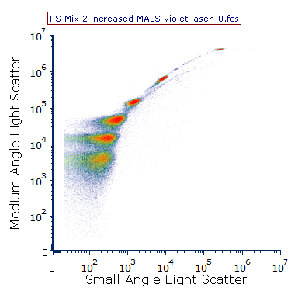
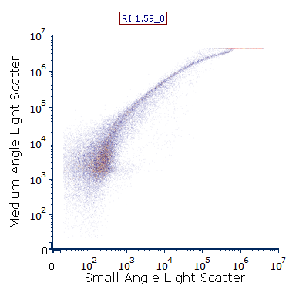
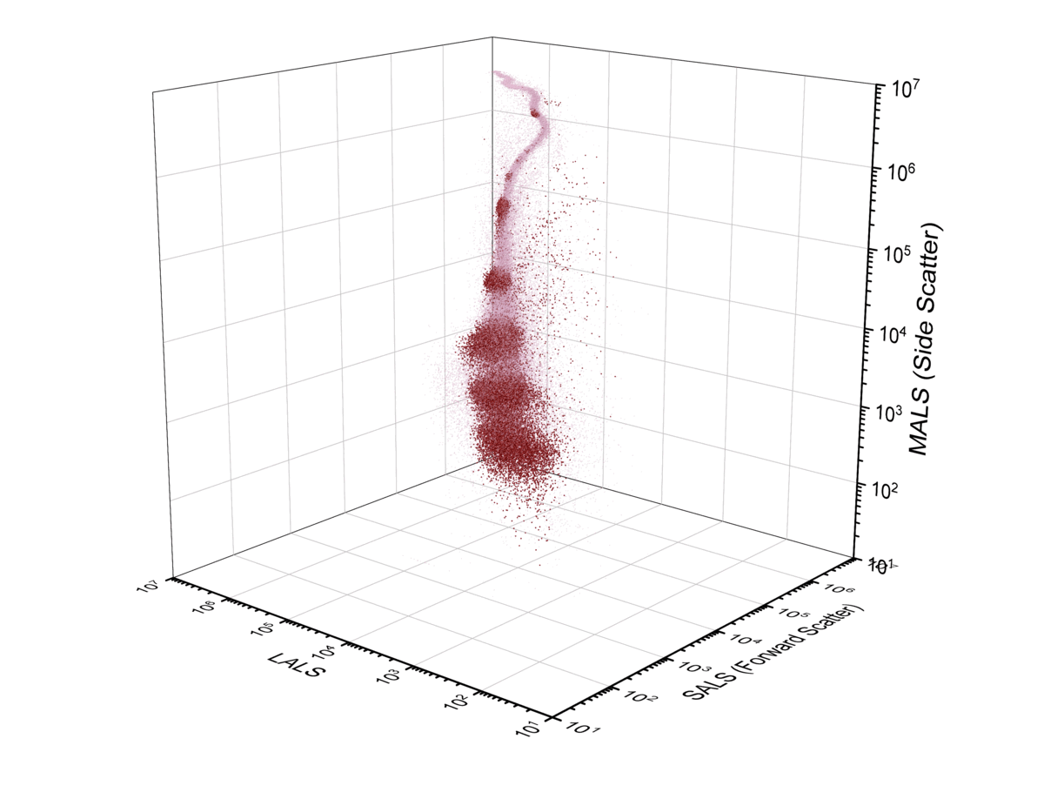
3.1 Common EV Bead Standards Overlay with Refractive Index Emulsion Oils
NIST (polystyrene) bead data overlaid almost perfectly with the 1.59 RI standard emulsion data.
400±9nmPS
203±4nmPS
152±5nmPS
122±3nmPS
100±4nmPS
81±3nmPS
● Cargille R.I. Ref Oil 1.5900
● NIST Polystyrene Standards

Slide 8
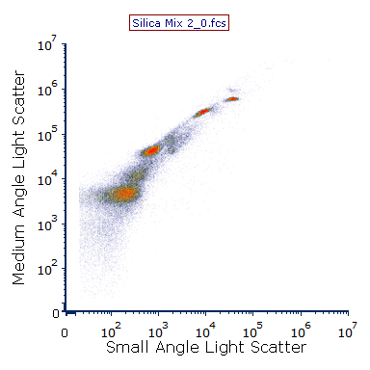
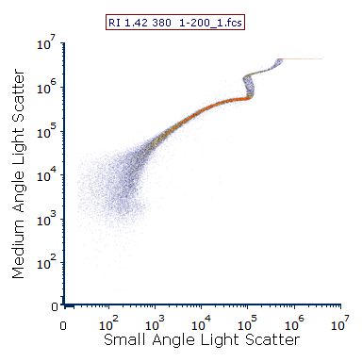
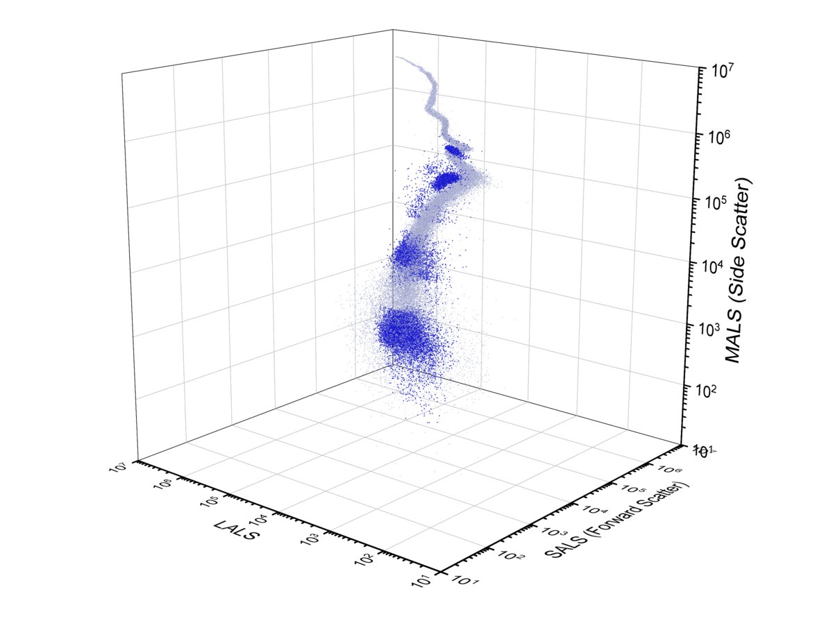
3.2 Common EV Bead Standards Overlay with Refractive Index Emulsion Oils
Silica bead standards followed the pattern of the 1.42 RI reference emulsions.
389nm±4nm Si
300nm±9nm Si
194nm±16nm Si
119nm± 6nmSi
● Cargille R.I. Ref Oil 1.4200
● Silica Standards

Slide 9
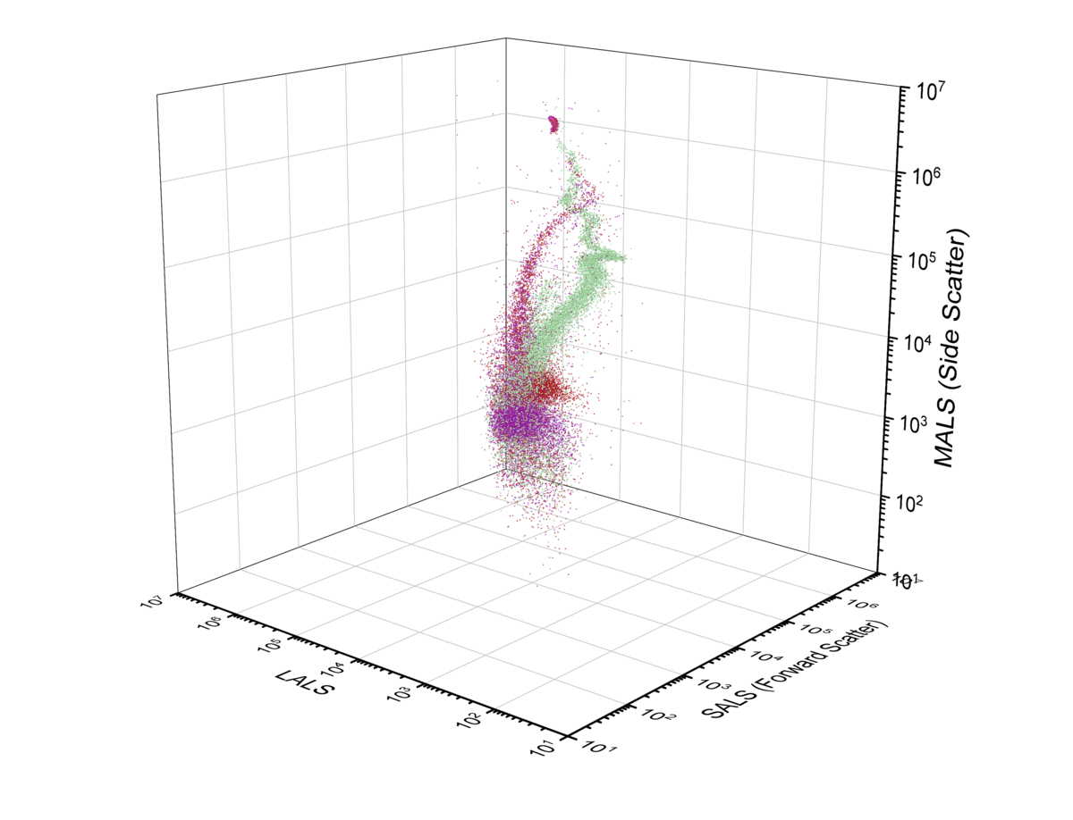
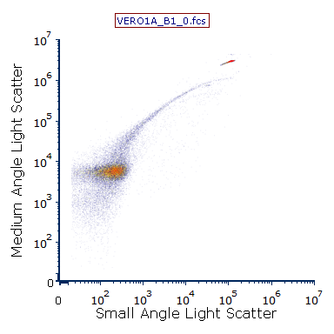
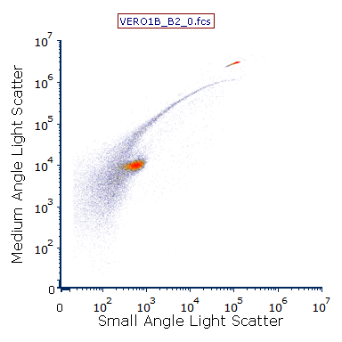
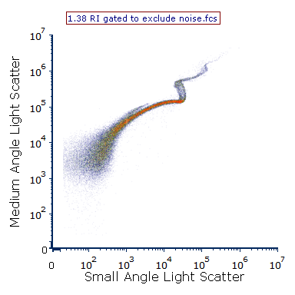
3.3 Common EV Bead Standards Overlay with Refractive Index Emulsion Oils
Verity beads (Exometry) overlaid near the 1.38 RI reference emulsions.
380nm PS Marker
380nm PS Marker
189nm±2nm OrganoSi
374nm±10nm OrganoSi
● Cargille R.I. Ref Oil 1.3800
● Verity Vero-01A
● Verity Vero-01B

Slide 10
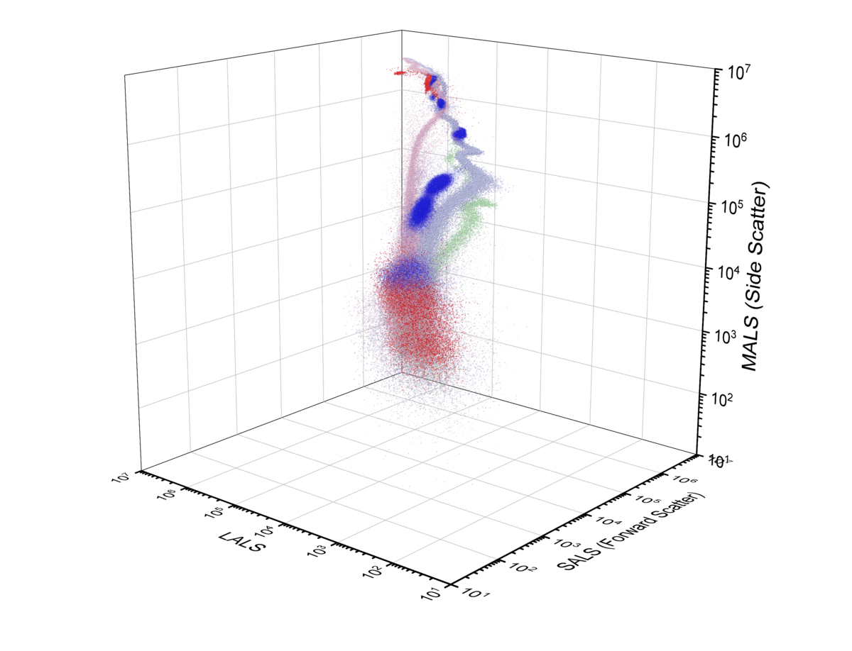
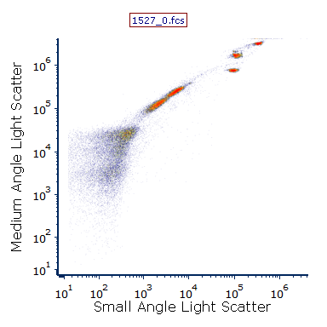
3.4 Common EV Bead Standards Overlay with Refractive Index Emulsion Oils
Apogee 1527 Si and Polystyrene beads overlaid with the expected emulsion profiles.
● Cargille R.I. Ref Oil 1.5900
● Cargille R.I. Ref Oil 1.4200
● Apogee 1527 Si Mixture
● Cargille R.I. Ref Oil 1.3800
● Apogee 1527 PS Mixture

Slide 11
Section 4.
How well do common bead standards match with refractive index oil emulsions?
Our data provide clear visual confirmation of
NIST bead overlay onto RI standard of 1.5900
Silica bead overlay onto RI standard of 1.4200
Verity bead overlay onto the RI standard 1.3800
Apogee mix overlay onto RI standards 1.5900 & 1.4200

Slide 12
Section 4.
How well do common samples used for EV analysis match with refractive index oil emulsions?
(4.1) Fasted plasma stained for CD41a (a common platelet marker) showed that platelets and platelet derived particles were integrated with both the RI1.38 profile and between the RI 1.42 and 1.59 emulsion profiles. Again, particles below ~180nm Si appear to merged with all RI emulsions.
Serum (4.2) gave a similar data as plasma.
First catch urine (4.3) yielded more smaller particles that appeared to be immersed between the RI1.38 and 1.42 emulsions, bigger particles appeared to have a higher refractive index.
Small particles from semen samples (4.4) were consistently between RI 1.42 and 1.38 emulsion profiles.
All particles from any sample below the ~180nm Silica size appeared to be merged within each of the emulsion profiles in this range.

Slide 13
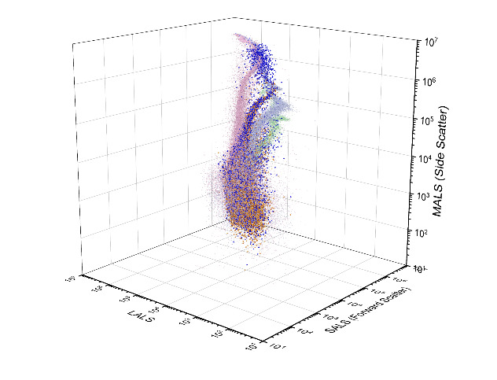
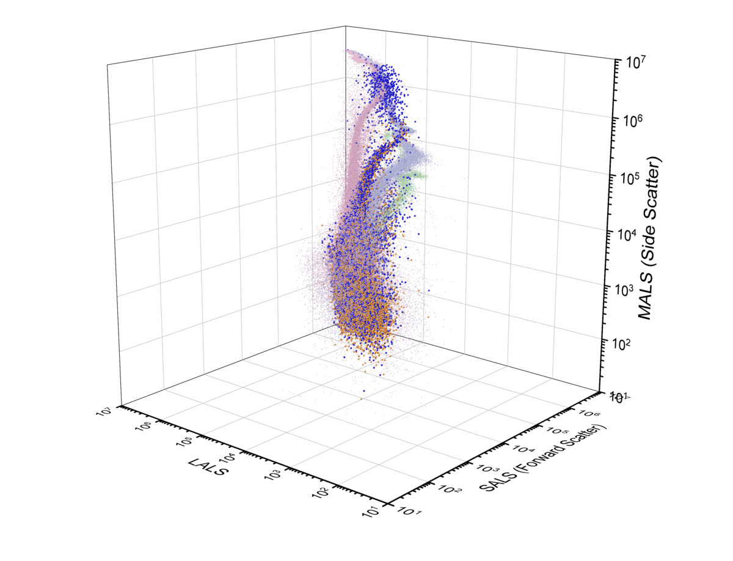
4.1 Common EV Sample Matrices Show Clear Patterns of Overlay & Separation with Refractive Index Emulsion Oils
● Cargille R.I. Ref Oil 1.5900
● Cargille R.I. Ref Oil 1.4200
● Cargille R.I. Ref Oil 1.3800
● EDTA (Fasted)plasma: CD41a POS
● EDTA (Fasted)plasma: CD41a Neg

Slide 14
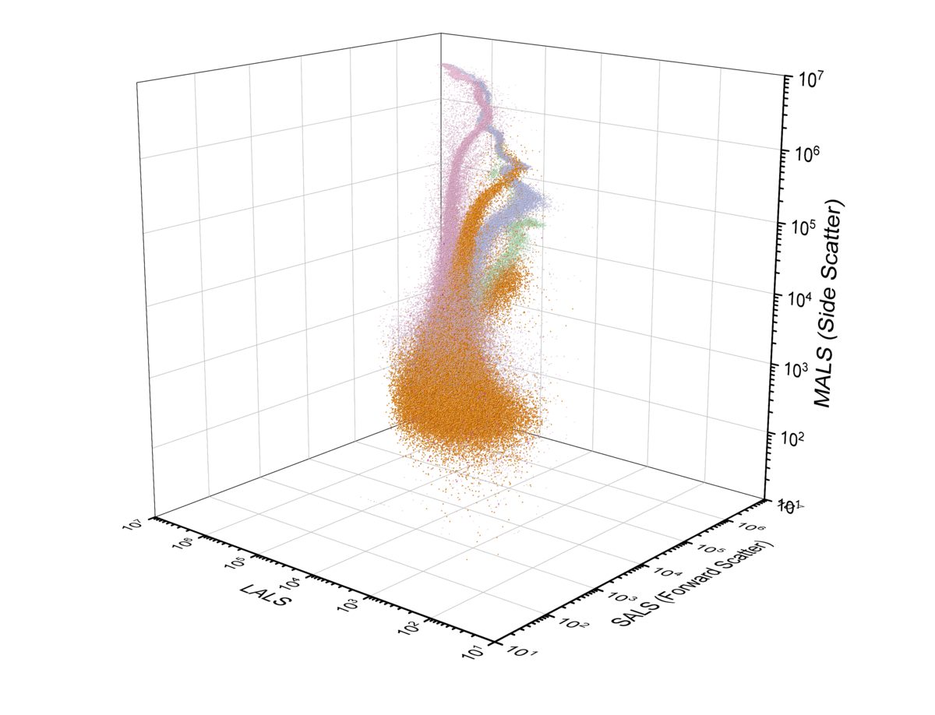
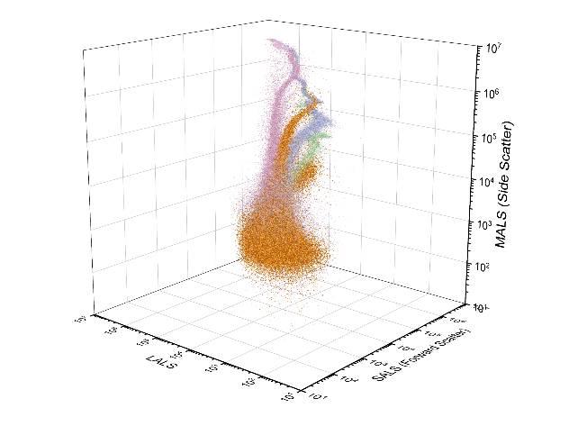
4.2 Common EV Sample Matrices Show Clear Patterns of Overlay & Separation with Refractive Index Emulsion Oils
● Cargille R.I. Ref Oil 1.5900
● Cargille R.I. Ref Oil 1.4200
● Cargille R.I. Ref Oil 1.3800
● SST Serum

Slide 15
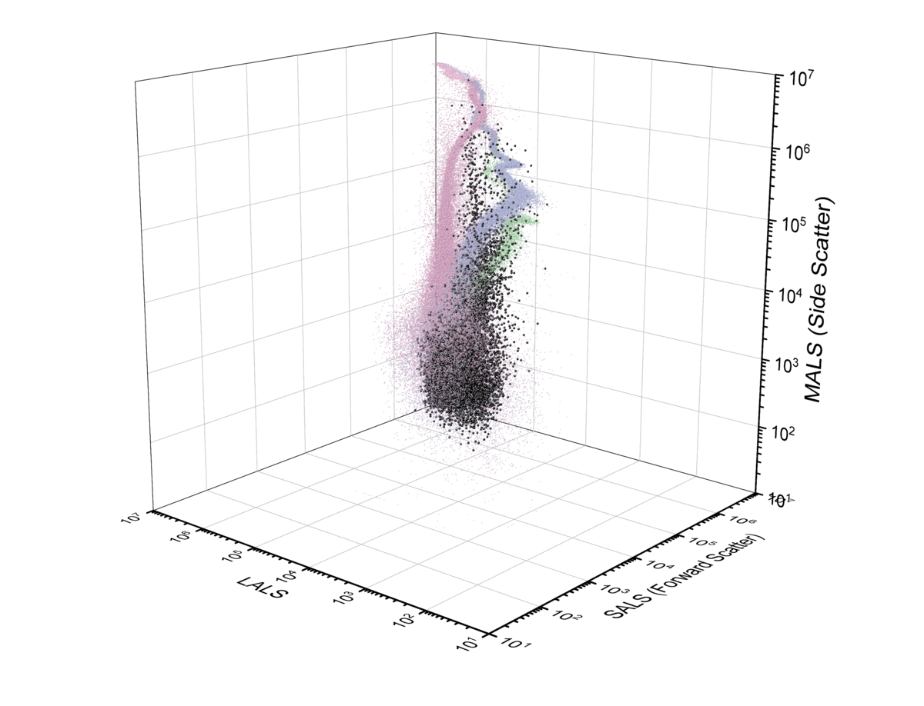

4.3 Common EV Sample Matrices Show Clear Patterns of Overlay & Separation with Refractive Index Emulsion Oils
● Cargille R.I. Ref Oil 1.5900
● Cargille R.I. Ref Oil 1.4200
● Cargille R.I. Ref Oil 1.3800
● First Catch Urine

Slide 16
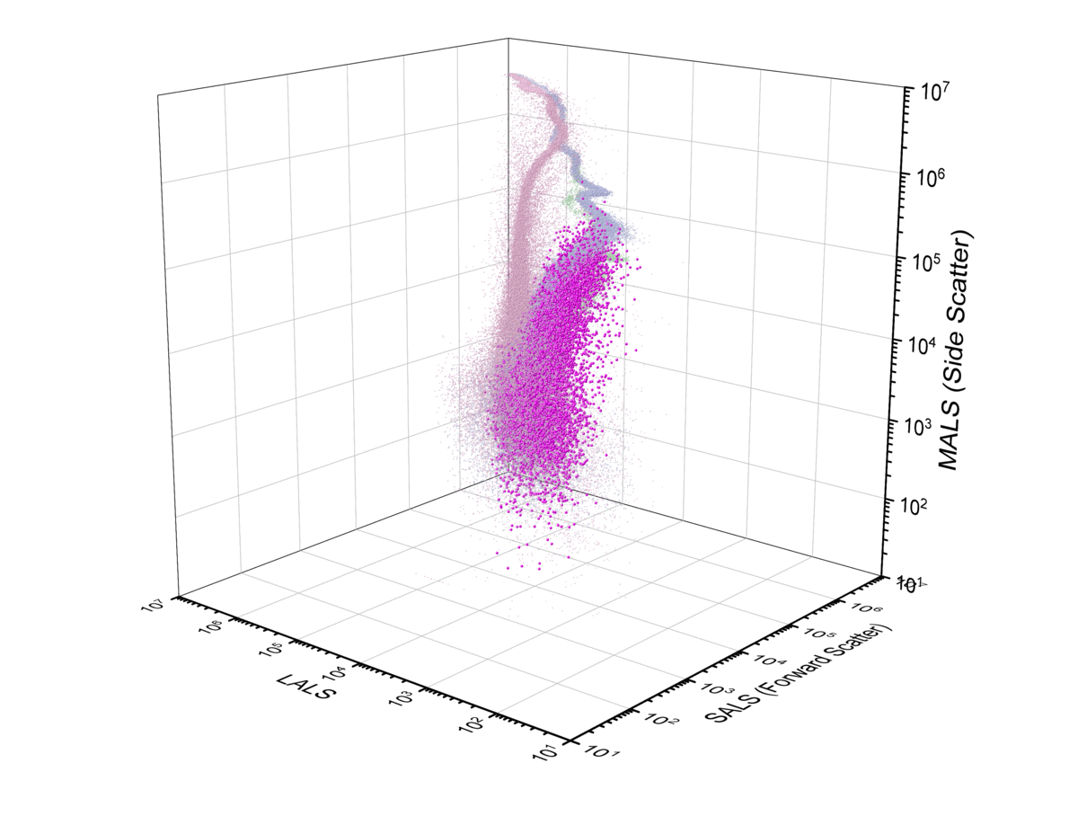

4.4 Common EV Sample Matrices Show Clear Patterns of Overlay & Separation with Refractive Index Emulsion Oils
● Cargille R.I. Ref Oil 1.5900
● Cargille R.I. Ref Oil 1.4200
● Cargille R.I. Ref Oil 1.3800
● Semen

Slide 17
Section 5.
How well do biological controls and standards used for EV analysis match with refractive index oil emulsions?
Biological control samples demonstrated unique profiles.
Intralipid (5.1) yielded a profile very similar to plasma (4.1) and serum (4.2).
The abnormal lipid mixture (5.2) had an excess of smaller particles that closely resembled the semen sample profile (4.4).
The high protein sample standard looked more closely like the profile of EVs in urine (4.3) or semen (4.4).
antibody aggregates (5.4) mostly resided in the area of merged emulsion profiles (<180nm Silica, (3.4)), but did not really have a cleanly defined profile matching either of the emulsions standards.

Slide 18
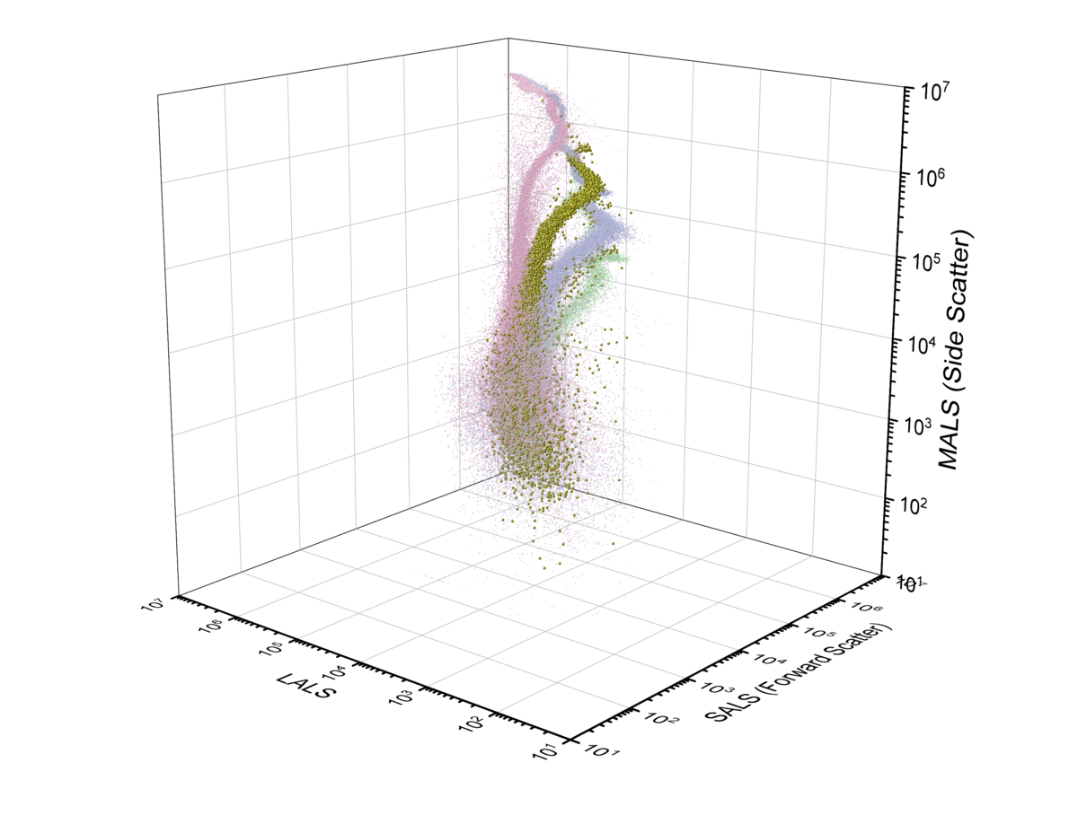

5.1 Biological Controls and Standards Show Clear Patterns of Overlay & Separation with Refractive Index Emulsion Oils
● Cargille R.I. Ref Oil 1.5900
● Cargille R.I. Ref Oil 1.4200
● Cargille R.I. Ref Oil 1.3800
● IntraLipid
Intralipid 20% (A 20% I.V. Fat Emulsion) Pharmacy Bulk Package is a sterile, non-pyrogenic fat emulsion intended as a source of calories and essential fatty acids for use in a pharmacy admixture program. It is made up of 20% Soybean Oil, 1.2% Egg Yolk Phospholipids, 2.25% Glycerin, and Water. Intralipid is commonly used to assess lipid interference in diagnostic assays.

Slide 19
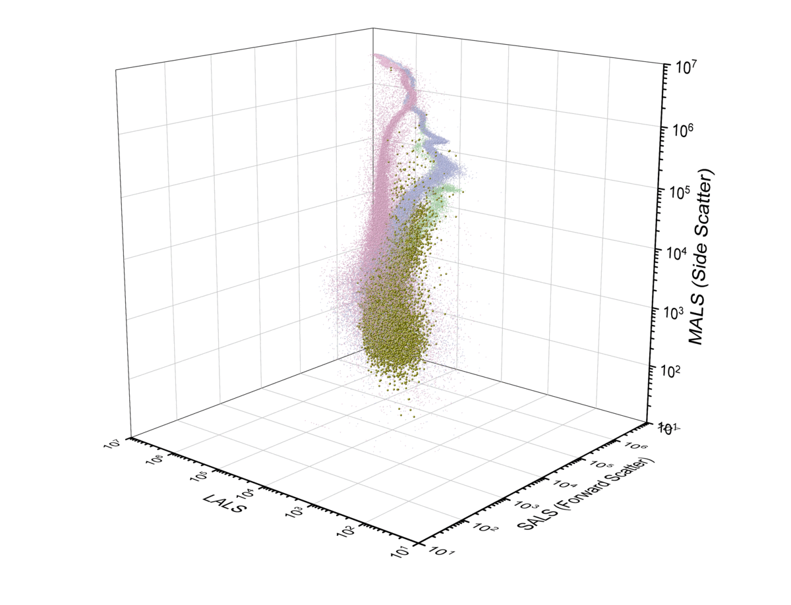

5.2 Biological Controls and Standards Show Clear Patterns of Overlay & Separation with Refractive Index Emulsion Oils
Cholesterol
TCh =287.5mg/dL
HDL = 68.0 mg/dL
LDL = 179.0 mg/dL
Tryglycerides
TG (total) =151.5mg/dL
TG (net) = 149.5 mg/dL
TG(free) = 2.0 mg/dL
Lipoproteins
ApoA1 =198.0mg/dL
ApoB= 155.5 mg/dL
Lp(a)) = 41.0 mg/dL
All values were established at the NorthWest Lipid Reference Laboratory (NWLRL), an established reference laboratory through the Cholesterol Reference Method Laboratory Network (CRMLN) and certifies manufacturers of clinical diagnostic products that measure total cholesterol, HDL-C, and LDL-C.
● Cargille R.I. Ref Oil 1.5900
● Cargille R.I. Ref Oil 1.4200
● Cargille R.I. Ref Oil 1.3800
● Abnormal Lipids (Solomon Park)

Slide 20
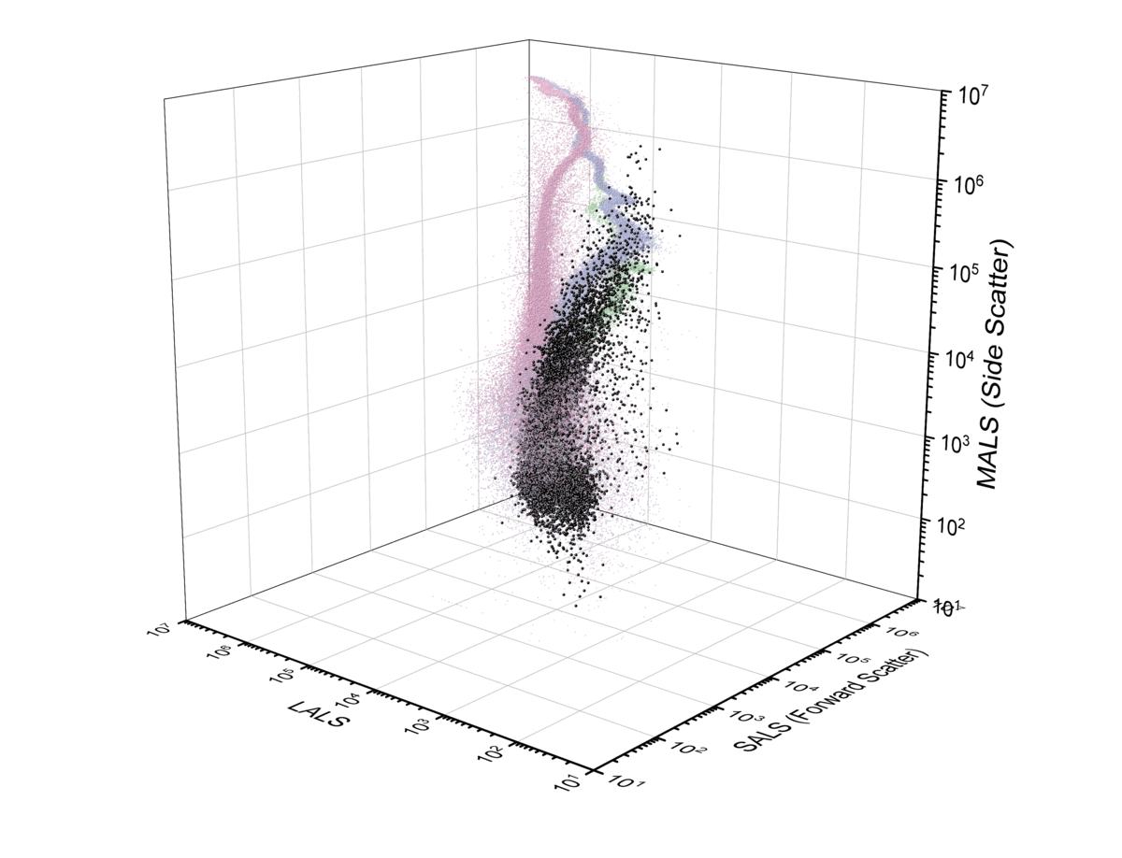
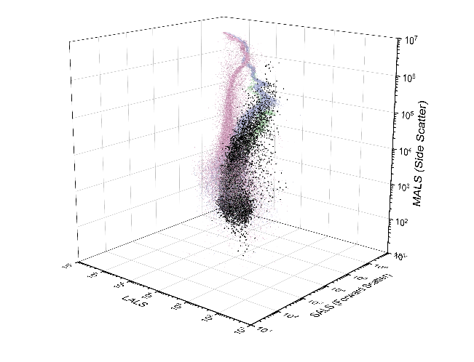
5.3 Biological Controls and Standards Show Clear Patterns of Overlay & Separation with Refractive Index Emulsion Oils
Source
Human serum albumin
Human γ-globulins
Stock Concentration
>20g/dL
Excess protein is commonly used to assess protein interference in diagnostic assays.
● Cargille R.I. Ref Oil 1.5900
● Cargille R.I. Ref Oil 1.4200
● Cargille R.I. Ref Oil 1.3800
● Excess Albumin, γ-globulins

Slide 21
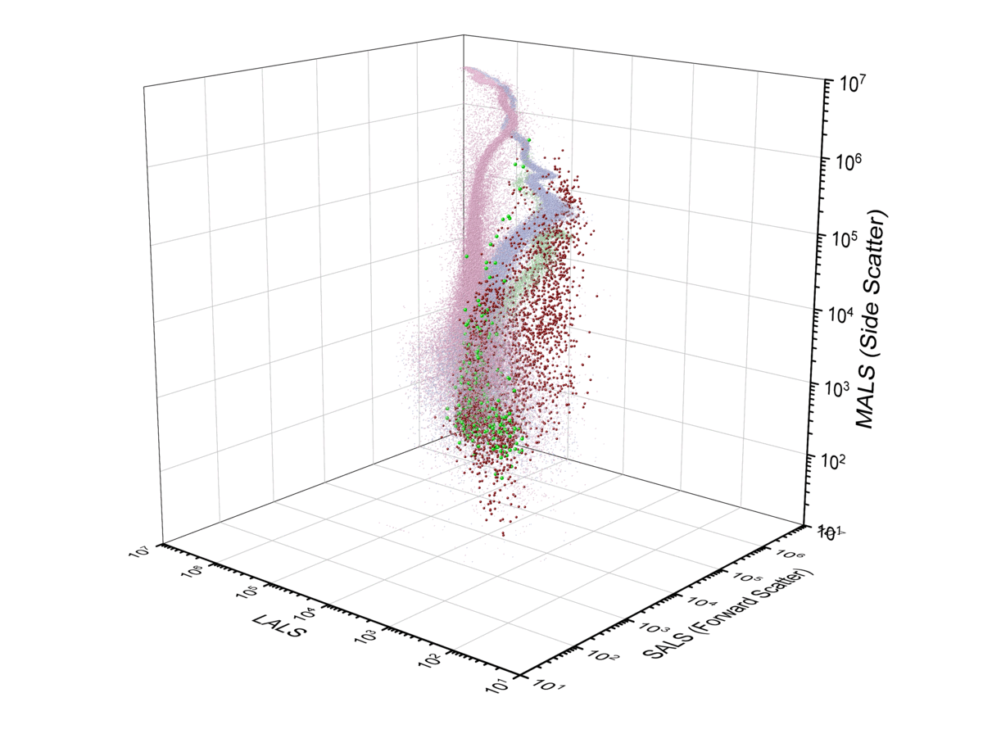

5.4 Biological Controls and Standards Show Clear Patterns of Overlay & Separation with Refractive Index Emulsion Oils
● Cargille R.I. Ref Oil 1.5900
● Cargille R.I. Ref Oil 1.4200
● Cargille R.I. Ref Oil 1.3800
● IgG-AF488 aggregates
● IgG-APC aggregates
Antibody aggregates are considered a common source of false positives in EV flow cytometry assays.
To generate aggregates, aliquots of expired antibody (IgG-APC, IgG-AF488) were incubated at 50°C for 90 minutes prior to analysis by flow cytometry.
Technique based upon Malvern Pananalytical application note AN140303 Aggregation in Proteins)

Slide 22
Section 6. Conclusions
Reference emulsion oils profile matched the refractive index profiles for bead standards commonly used as size references (section 3).
Samples commonly used in extracellular vesicle analysis showed both distinct refractive index profiles as well as overlapping profiles (section 4).
Biological controls for lipids and lipid mixtures showed unique profiles independent of the three reference oils tested (section 5).
As light scatter intensity decreases with particle size the effective separation of particles of different RI is confounded by the overlap of signals.
Addition of a 3rd light scatter collection significantly enhances the analysis of EVs by small particle flow cytometry, but practical thresholds still exist.

Slide 23
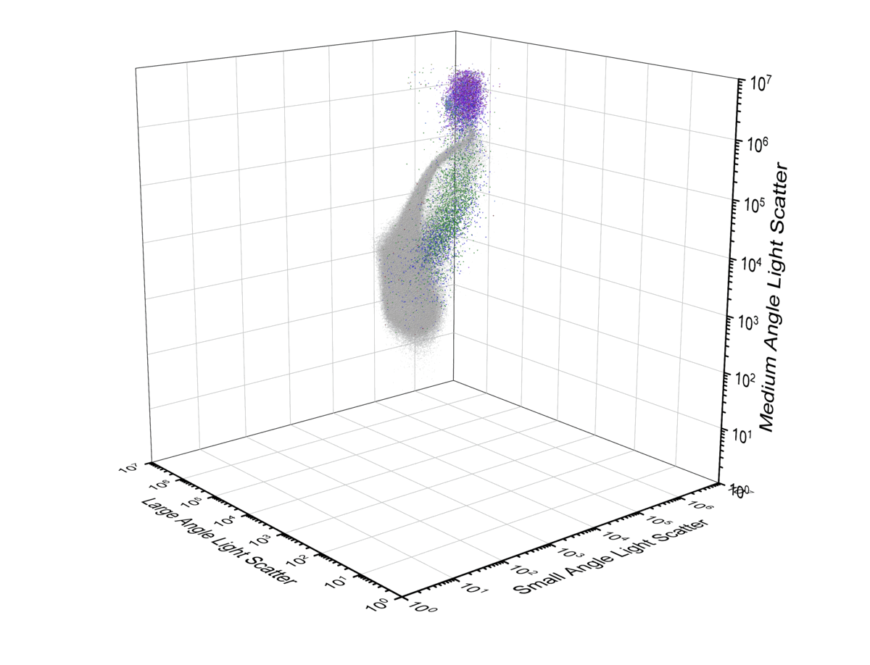
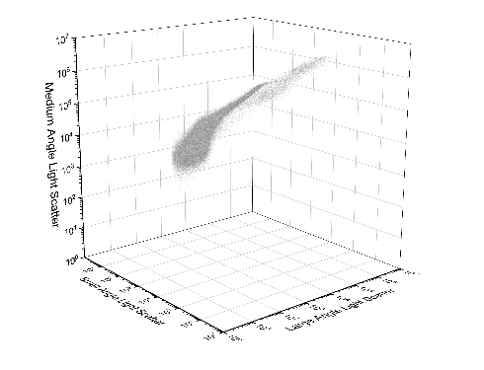
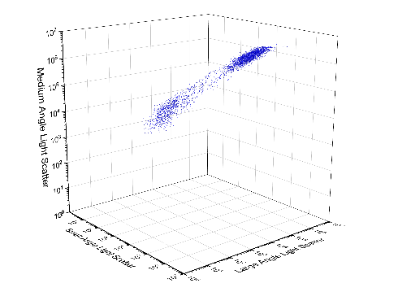
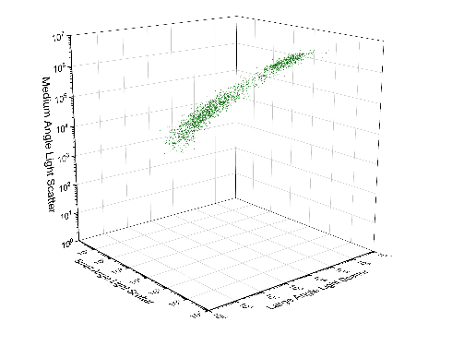
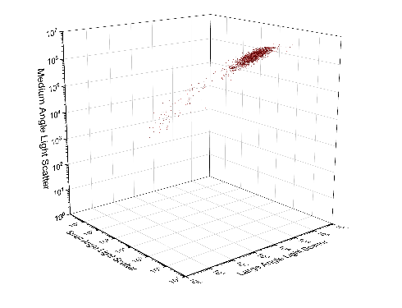
Section 6. Additional Data Overlays: Plasma
● Unstained Fasted Plasma sample
● CD41a eFluor450
● CD63-APC
● CD81 FITC

Slide 24
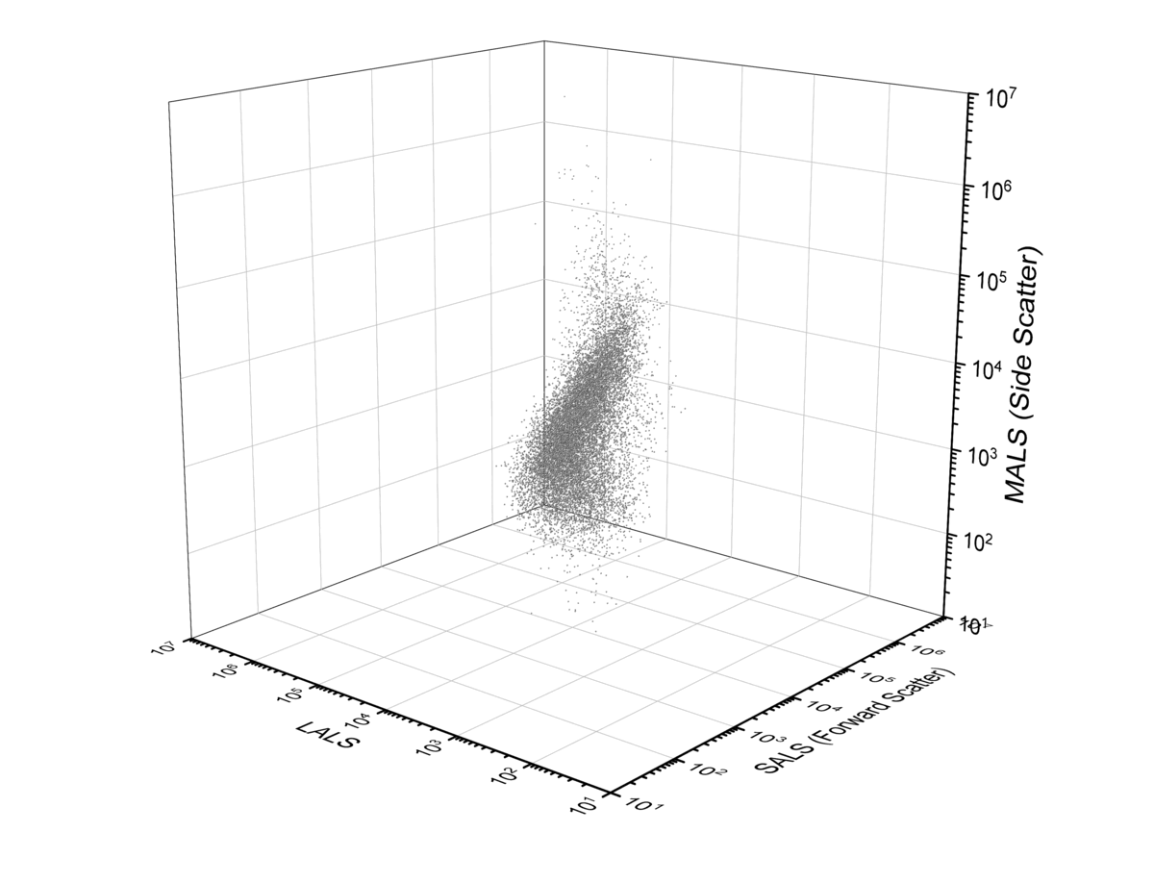
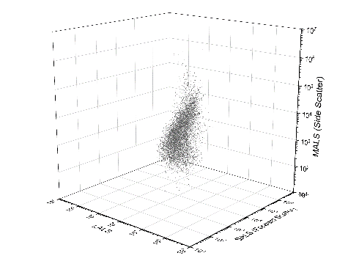
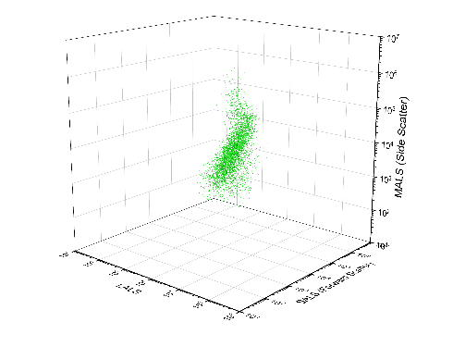
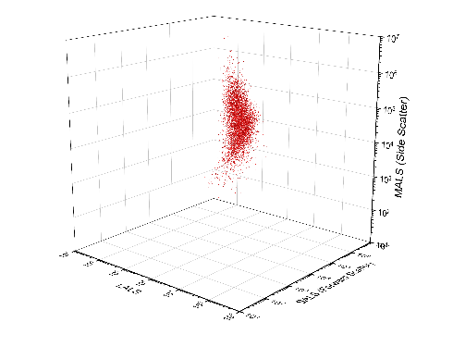
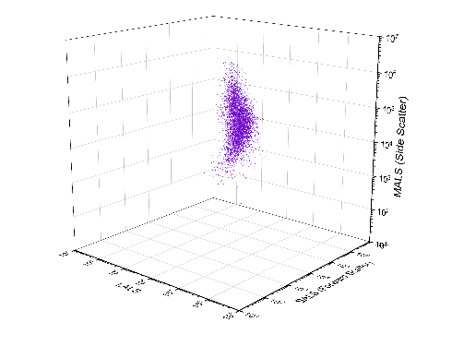
Section 6. Additional Data Overlays: Syncytiotrophoblast Extracellular Vesicles (STBEVs)
● Unstained STBEVs sample
● PLAP POS in CFSE POS Gate
● CFSE POS
● PLAP (APC) POS

